Slide 1
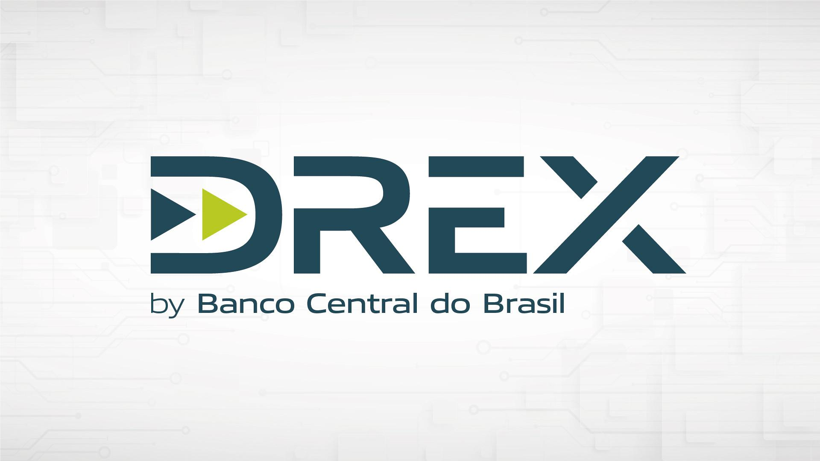
DShield
KYC is dead!

Slide 2
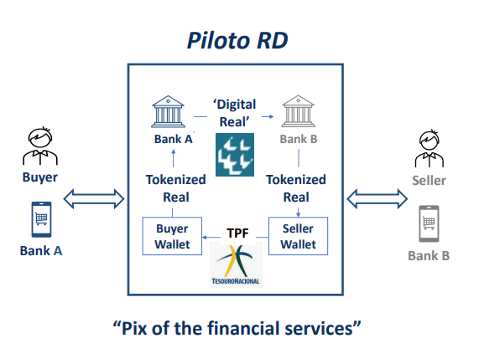
SUMMARY
3. PROBLEM
4. SOLUTION
5. REVENUE
6. FUNDING P1
7. FUNDING P2
8. TEAM P1
9. TEAM P2
10. CONCLUSION
11. GET IN TOUCH
12. LINKS

Slide 3
PROBLEM
Brazil is on the verge of launching ‘Drex’, a Central Bank Digital Currency (CBDC) empowered by a private blockchain. While the focus is primarily on the seamless transfer of funds, we recognize the critical importance of addressing issues such as money laundering and illicit financial activities.
‘Before we find world peace, we gotta find peace in the war on the streets.’ - Tupac Shakur.
While our tool has the capability, will, and the potential to combat terrorism, money laundering for terror, and the financing of terrorist entities, our primary focus is on addressing domestic issues, our ‘croocks’. We aim to tackle local crime, criminal activities, and everything 'in house.' We firmly believe that by directing our efforts to keep our house 'clean,' positive outcomes will naturally extend to broader areas.

Slide 4
SOLUTION
In contrast to future considerations, our approach is proactive and immediate. We declare the end of KYC and say ‘hi’ to KYT. KYC (Know Your Customer) processes are susceptible to forgery. While KYC relies on individuals who may sell accounts at any time, KYT is centered around history, tracking, and technology (including AI).
With high technology To safeguard against financial crimes, we will employ proprietary data analysis, ML and forensic tools. Our monitoring system complies with privacy laws and the LGPD (Lei Geral de Proteção de Dados) with guidance from legal experts. The primary objective is to provide a transaction score to ecosystem participants such as stores, neobanks, and exchanges. This score, based on transaction history, enables them to assess and approve or deny transactions. Institutions can set a minimum score threshold, and any transaction falling below this threshold will be automatically rejected.

Slide 5
REVENUE MODEL
At the core of our revenue model is the transaction score system. DShield will offer a comprehensive API service, allowing ecosystem participants—stores, neobanks, and exchanges—to access transaction scores and real-time analysis. The pricing will be tiered, with more detailed and specific insights commanding a higher cost. This innovative approach not only generates revenue for DShield but also empowers businesses to make informed decisions, preventing illicit activities and enhancing the integrity of their platforms and only pay for what they use.

Slide 6
DEVELOPMENT AND FUNDING PLAN - P1
Total Funding: $200,000 USD
The $200,000 funding will be strategically allocated to ensure the successful development and launch of DShield:
1. Development Environment and Simulation (7%): Mimicking the DShield system to identify potential issues and challenges.
2. MVP Development (13%): Creating a Minimum Viable Product tailored to the DShield platform.
3. AI-Infused Database and Algorithm (10%): Developing an intelligent algorithm for a fair and practical daily transaction score.
4. Legal Compliance and Company Formation (12%): Assembling a legal team to ensure adherence to Brazilian laws and regulations, including costs associated with company formation.
5. Programming Team (15%): Recruiting skilled programmers for system development and maintenance.

Slide 7
DEVELOPMENT AND FUNDING PLAN - P2
6. Infrastructure (8%): Acquiring necessary hardware infrastructure, preferably on a secure cloud platform.
7. Thorough Testing (4%): Conducting rigorous testing to guarantee the reliability and security of the system.
8. Marketing Strategies (4%): Implementing effective marketing strategies to promote awareness and adoption.
9. Initial Project Expenses (5%): Covering miscellaneous initial expenses associated with the project, including legal consultation.
Running Costs for First Year (22%):
10. Operational Expenses: Covering salaries, utilities, office space (if applicable), and other day-to-day operational costs for the first year.

Slide 8
TEAM - p1
Marcos Oliveira - Solo Founder and Visionary
As the visionary behind DShield, Marcos Oliveira brings a decade of immersive experience in the crypto industry. His journey has been marked by diverse roles, providing a comprehensive understanding of the dynamic crypto landscape.
Marcos has been instrumental in significant initiatives, from deanonimizing Brazilian exchanges' hot-wallets to collecting and mapping seeds from dark web entities. His expertise extends to monitoring and extracting information from various criminal groups across platforms such as Telegram.
Entrepreneurial Achievements:
While working as a regional manager, Marcos made pioneering contributions to the crypto market. He was the first to introduce PIX to the P2P market, resulting in a significant boost to the company's crypto sales. Additionally, in 2008, Marcos was among the first Brazilians to own a white-label poker room, showcasing his entrepreneurial spirit and foresight.

Slide 9
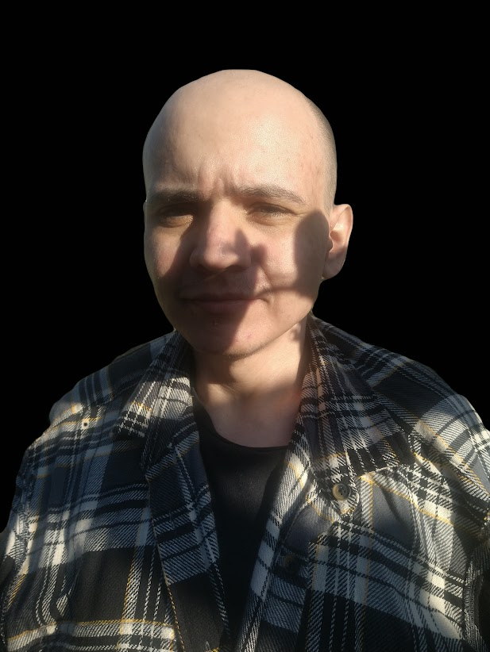
TEAM - p2
Founder's Commitment:
As a self-taught professional, Marcos demonstrates a remarkable ability to navigate challenges within the crypto space. DShield is not just a project; it's the manifestation of one individual's dedication and passion for making a meaningful impact in the industry.
Looking Ahead:
As DShield evolves, Marcos anticipates forming a team that shares the same enthusiasm for revolutionizing the expansion of the brazilian CBDC landscape. The journey begins with a solo founder who believes in the transformative potential of DShield.

Slide 10
CONCLUSION
In conclusion, Drex and DShield represents a pivotal step toward revolutionizing the Brazilian financial ecosystem. By prioritizing security, compliance, and transparency, we aim to not only address current challenges but set new standards for digital financial transactions. DShield aligns seamlessly with the broader goals of financial security, regulatory compliance, and user trust, making it a pioneering force in the evolving landscape of digital currencies in Brazil. We invite you to join us on this transformative journey towards a secure and trustworthy financial future. Your support will not only drive the success of Drex but contribute to reshaping the future of digital finance in Brazil.

Slide 11
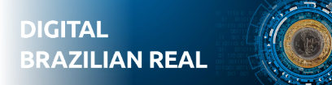
GET IN TOUCH
+55 (19) 9 8313-5034
marcos@annibale.me
annibalebea@gmail.com
https://Annibale.me

Slide 12
LINKS
https://www.bcb.gov.br/en/financialstability/drex_en
https://www.bis.org/publ/arpdf/ar2021e3.htm
https://research.stlouisfed.org/publications/review/2021/02/05/decentralized-finance-on-blockchain-and-smart-contract-based-financial-markets
https://www.fsb.org/wp-content/uploads/P131020-3.pdf
https://www.bcb.gov.br/content/about/presentationstexts/Digital_Brazilian_Real_Press_Conference_Guidelines_Pilot_RD_Mar2023.pdf
https://www.kaleido.io/

